Slide 1

Eva Primus Kovandova
Director of Chamber of Commerce in Prague
BUSINESS FOR WOMEN
IN THE CZECH REPUBLIC

Slide 2
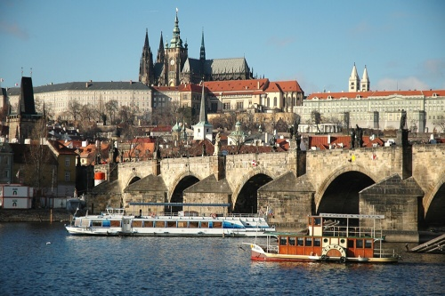
THE CHAMBER OF COMMERCE PRAGUE 1
EVA PRIMUS KOVANDOVÁ

Slide 3

BUSINESS FOR WOMEN IN THE CZECH REPUBLIC

Slide 4
BUSINESS FOR WOMEN IN THE CZECH REPUBLIC
Czech women are educated and not afraid to start a business.
The number of female graduates and businesswomen is increasing in the CR.
Among young women, over 40% are university students, almost 13% more than young men.
Women still dominate starting entrepreneurs and sole traders in the CR.
Yet women still make less money than men.

Slide 5
10 most influential women in the Czech Republic

Slide 6
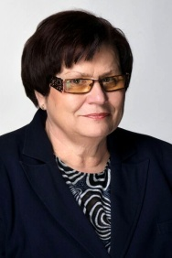
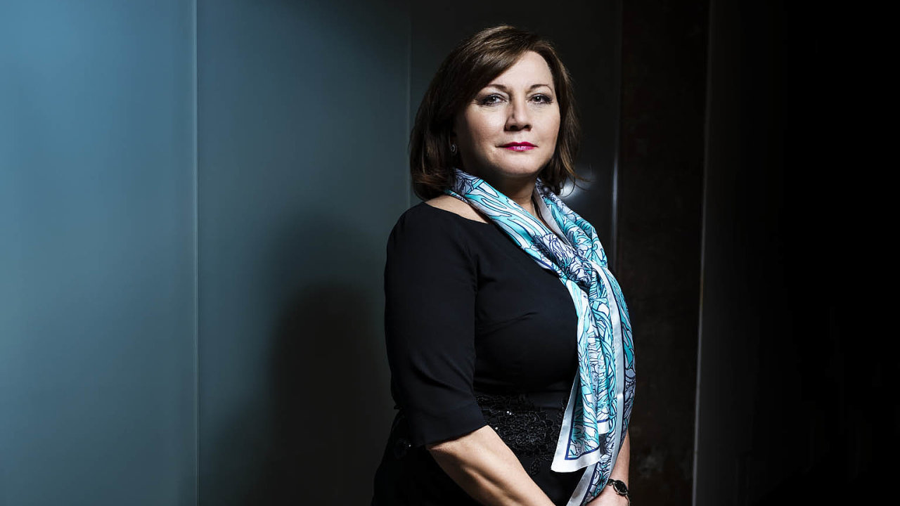
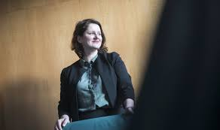
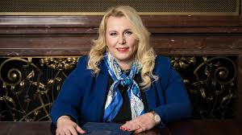
Women in politics
The Czech Republic ranks 70th out of 152 countries in the Global Gender Gap Report 2020 ranking.
The Czech government consists of 10 men and “only” 4 women.
Alena Schillerová - Minister of Finance
Jana Maláčová – Minister of Labor and Social Affairs
Marie Benešová – Minister of Justice
Klára Dostálová – Minister of Regional Development

Slide 7
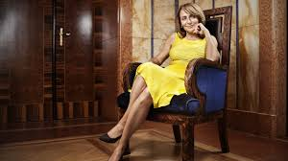
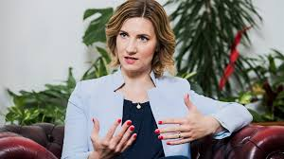
Women in politics
ADRIANA KRNÁČOVÁ – 1st Female Mayor of Prague (2014-2018)
MARKÉTA VAŇKOVÁ – 2nd Female Mayor of Brno

Slide 8
LADY CLUB OF THE CHAMBER OF COMMERCE IN PRAGUE 1
Exclusively for women - entrepreneurs, managers of CHCP1 member companies, women who are starting a business
We support and encourage success, cooperation, knowledge, professionalism and ideas.
The goal of the LADY CLUB is to connect all successful women and to provide support for their businesses.

Slide 9

THANK YOU FOR YOUR ATTENTION

